Slide 1
Joining a Domain

Slide 2
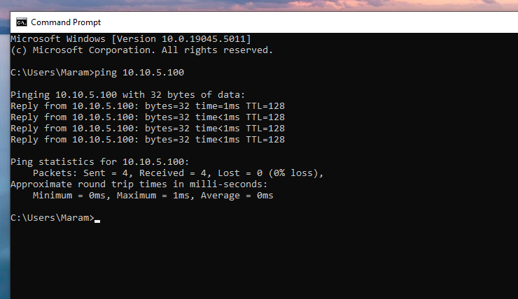
Check the link with the DC
Set the DNS first
Set the IP address on the same range of the DC.
Use the DC as DNS.

Slide 3
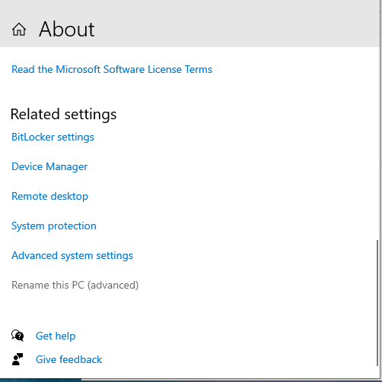
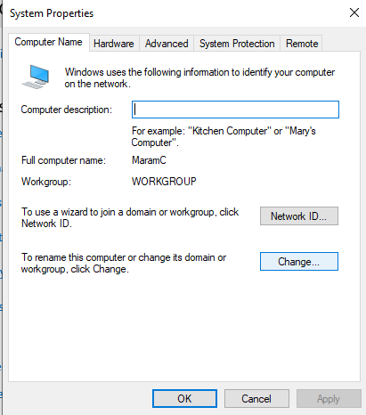
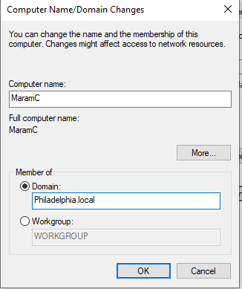
Join the Domain

Slide 4
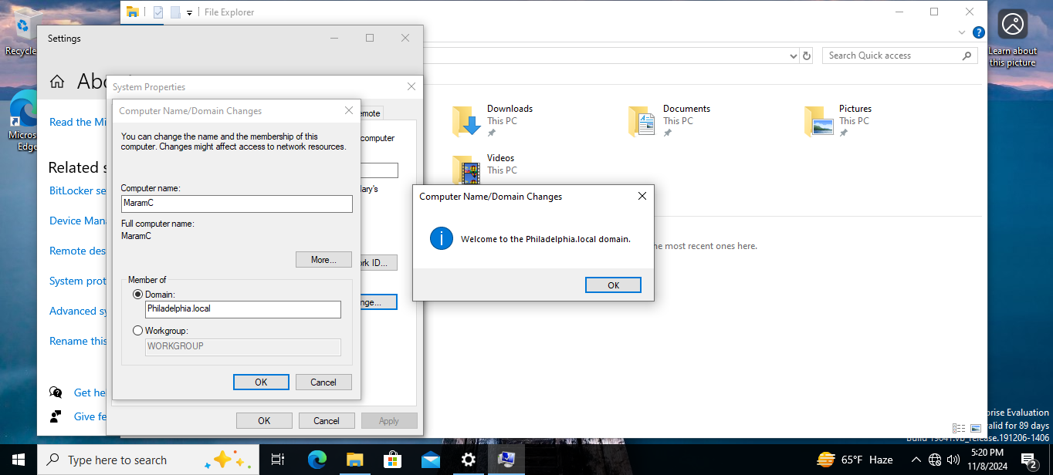
Each User can join by default to 10 devices
Enter UserName and Password registered on the domain controller

Slide 5
Sign in
You can sign in in this client Device to any user name in the DC.
The Domain Name appear under the sign in input boxes.
If you want to sign in any account localy on the device you need to use “.\” before the name.

Slide 6
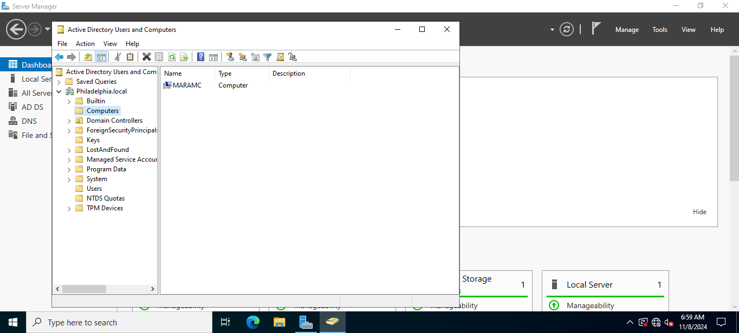
Inside the computer domain you can find the joined computer

Slide 7
Any device in the domain can be used to join the device to a domain
Only local admin or DC domain can un-join the device from a domain.

Slide 8
Un-JOIN
Same Steps but in opposite order.

